Slide 1
Classification of Acute Lymphoblastic Leukemia
Kshetrimayum Paresh Singh 23160
Kushagra Agarwal 23162
Abhishek Nair 23009

Slide 2
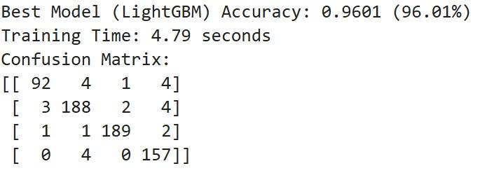
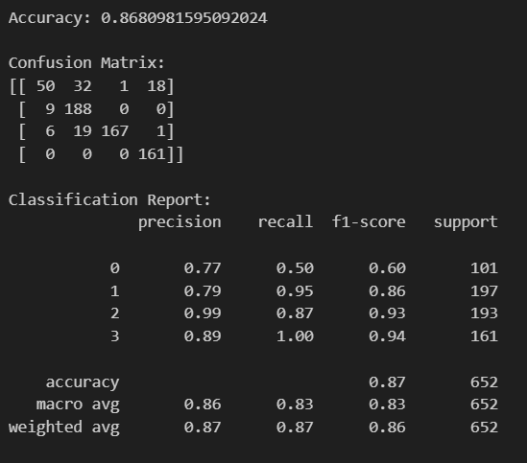
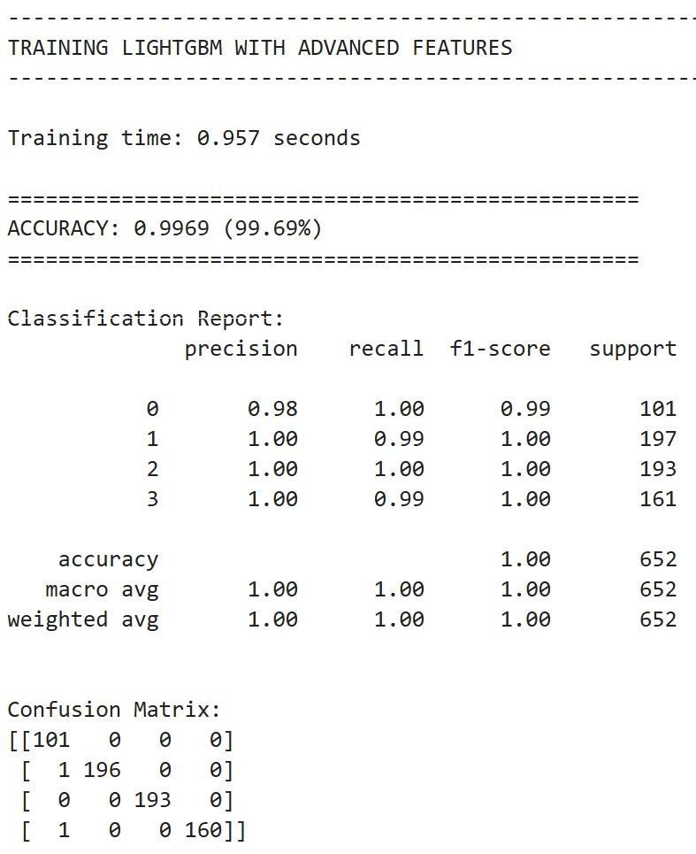
Medically Relevant Features
BASELINE MODEL: Random Forest directly trained on pixels values
GOOD!! ✅
BAD!!! X
Complex Features

Slide 3
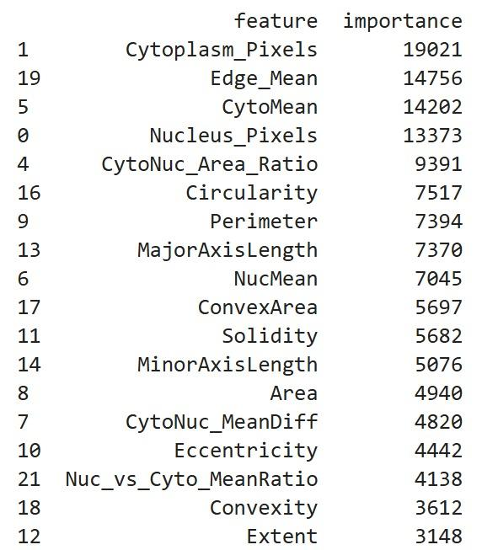
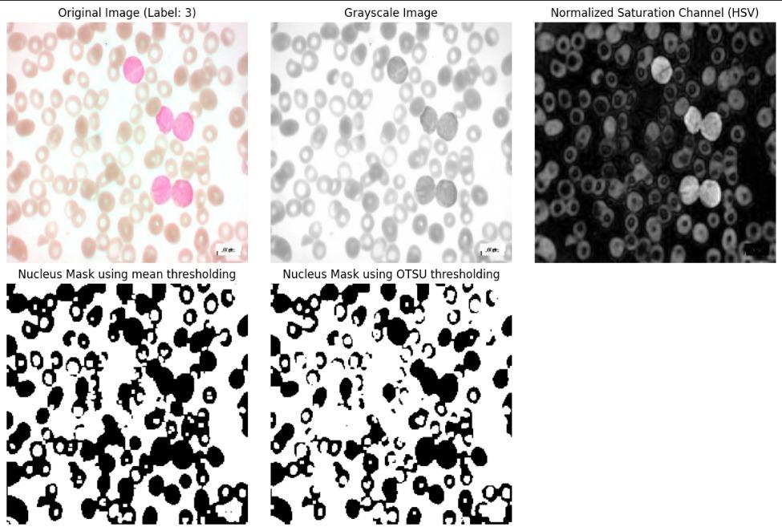
Feature Extraction:
Manual Feature Extraction
22 features extracted that was cut down to 18
Nucleus - Cytoplasm features and Shape features are the main features of our model

Slide 4
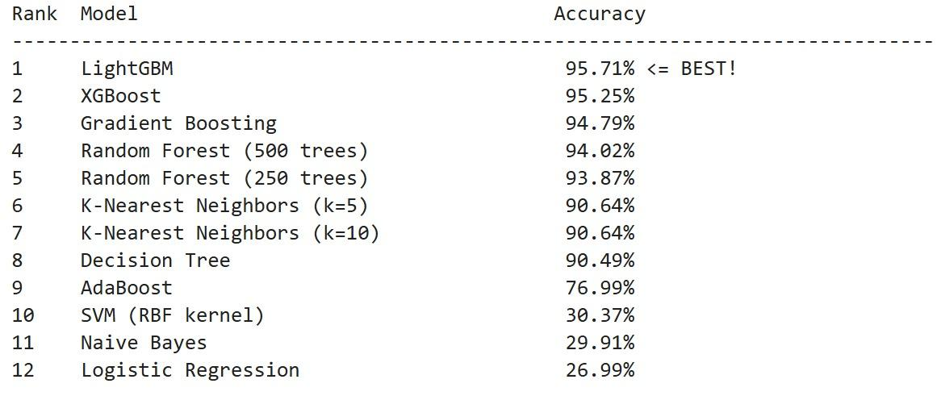
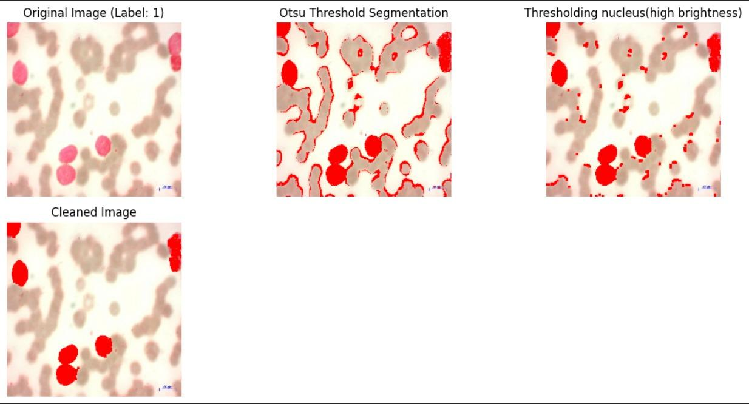
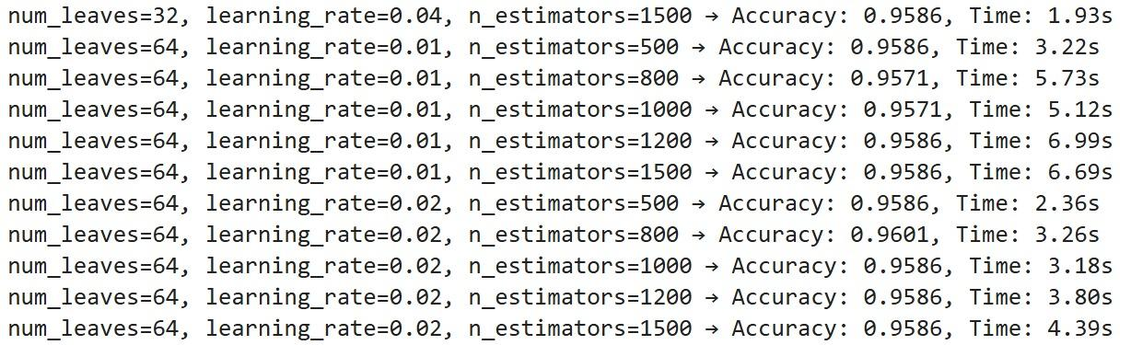
Main Challenge & Models Comparison:
FINE TUNING THE BEST MODEL
The PBS images have RBCs and different types of WBCs. We had to identify RBCs and WBCs and identify the lymphoblasts with clear nucleus and cytoplasm.

Slide 5
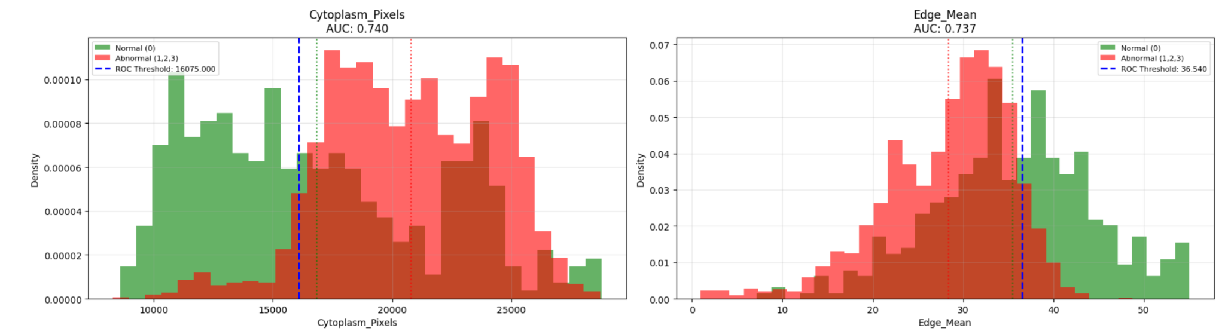
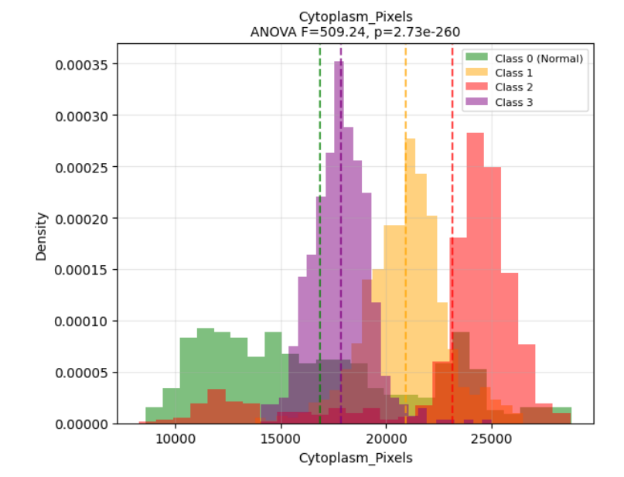
Thresholding
Normal vs Abnormal
ROC Curve Analysis
Distribution Analysis
Decision Tree Split Points
Multi-Class Thresholding
One vs Rest ROC Analysis
Statistical Range Analysis
Decision Boundary Ranges

Slide 6
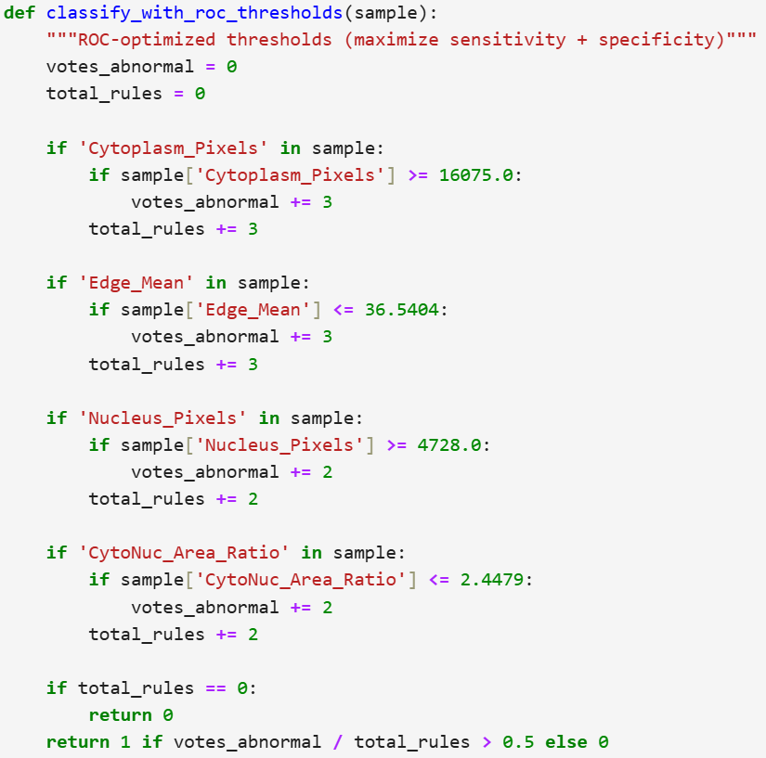
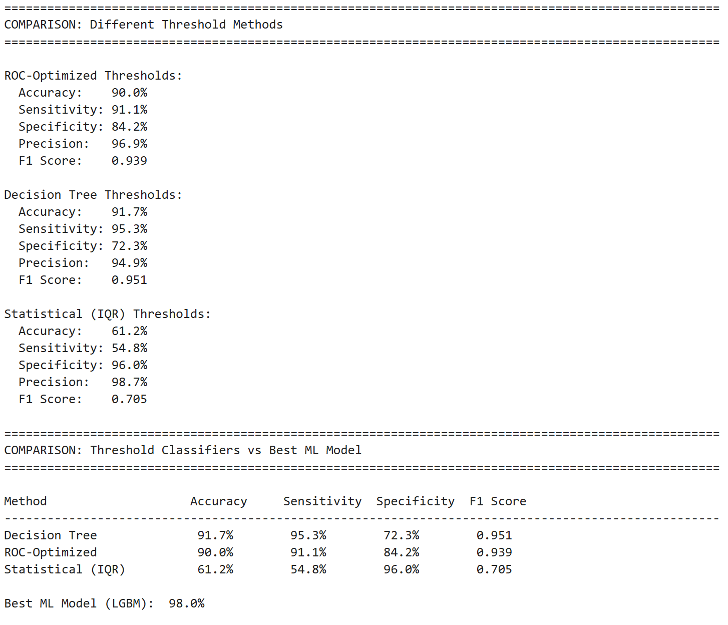
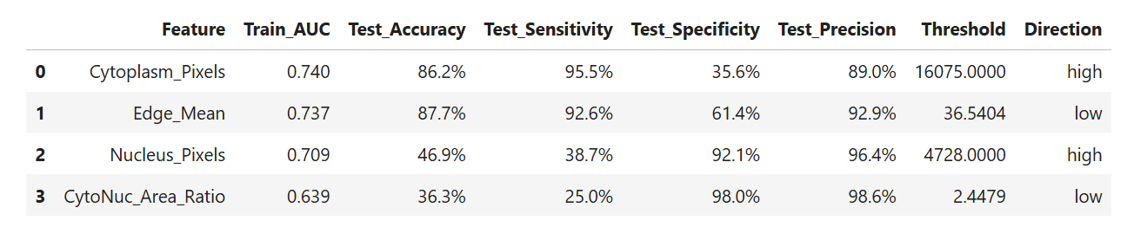
Results:
Our final model was an
IF-ELSE MODEL!

Slide 7
THANK YOU!
Contributions:
Kshetrimayum Paresh Singh and Abhishek Nair: Worked on Feature Extraction
Kushagra: Worked on Model building and interpretation

